Slide 1
Digital Payments & UPI Transaction Analytics
Trends, Growth & Business Insights
Presented by: Priya Diwan

Slide 2
Introduction
This is a data analytics project developed to understand UPI transaction trends, growth patterns, and app performance. It helps convert raw transaction data into clear, data-driven insights, helping digital payment platforms make data-driven business decisions.

Slide 3
Technologies Used
Python – Data cleaning, preprocessing & analysis
SQL – Data querying and analysis
Excel – Data storage
Power BI – Interactive dashboards and data visualization

Slide 4
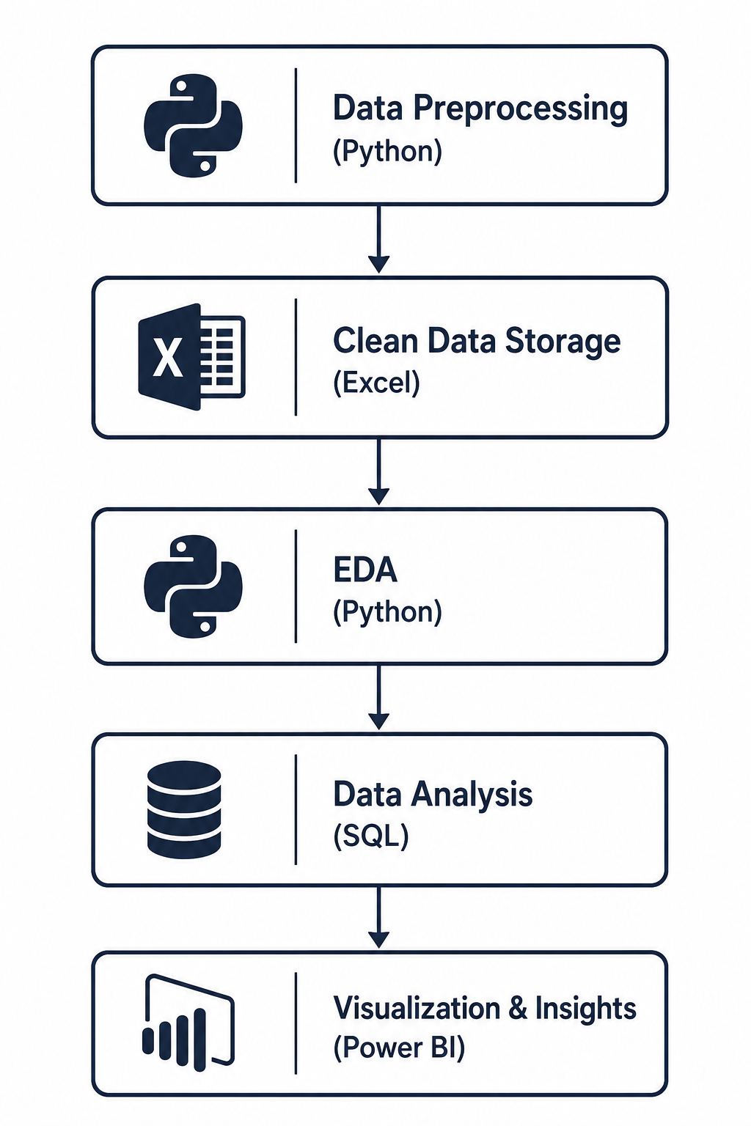
Project Workflow

Slide 5
Final Insight
UPI adoption is growing strongly, with PhonePe leading the market. Customer transactions contribute the most to overall UPI activity, showing strong customer usage and continued growth in digital payments.

Slide 6
Future Scope
Integrate live UPI transaction data for continuous monitoring and analysis.
Include customer demographics to better understand user behavior and preferences.
Use Machine Learning to predict future UPI transaction trends.
Detect suspicious transaction patterns to improve fraud prevention.

